Slide 1
3D Printing Beginner
Sam Bischel
Make717 Innovation Center

Slide 2
Emergency Contacts
Calling Order:
Emergency – 911
TSCT Security – (717)-606-1564
PA State Police – (717)-299-7727
Make717 Organizers – (717)-368-2919

Slide 3
Printer Safety
There are a lot of open and moving components on the printers. Loose clothing, long hair, anything that dangles, should be pulled back and kept away from the motion systems
There are also extremely hot components that can reach temperatures of over 290˚C. Touching these parts is probably not a good idea…

Slide 4
Material Safety
The material used in 3D Printing can be extremely dangerous. This more of a concern with the Formlabs but still applies to FDM printers. A SDS or Safety Data Sheet, sometimes referred to as a MSDS or Material Safety Data Sheet, must be filed for all materials used AND stored at make717. A list of already approved materials and manufacturers can be found on our website.

Slide 5
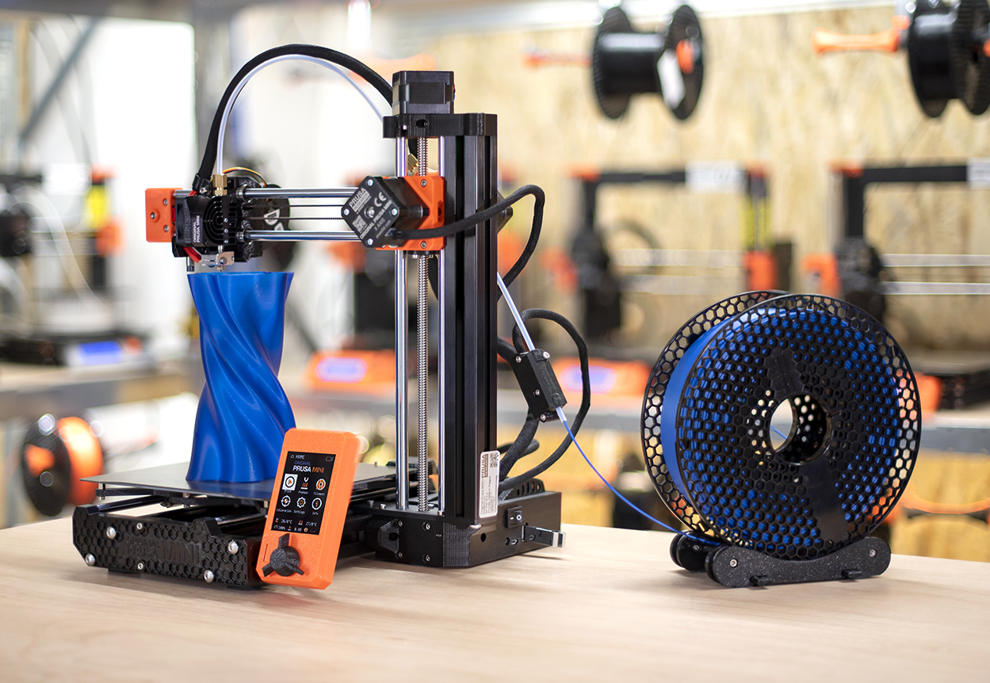
Prusa Mini Introduction
Prusa Mini+
180 x 180 x 180 mm | 7 x 7 x 7 in
Nozzle diameter:0.4mm
Max nozzle temperature: 280 °C / 536 °F
Max heatbed temperature: 100 °C / 212 °F

Slide 6
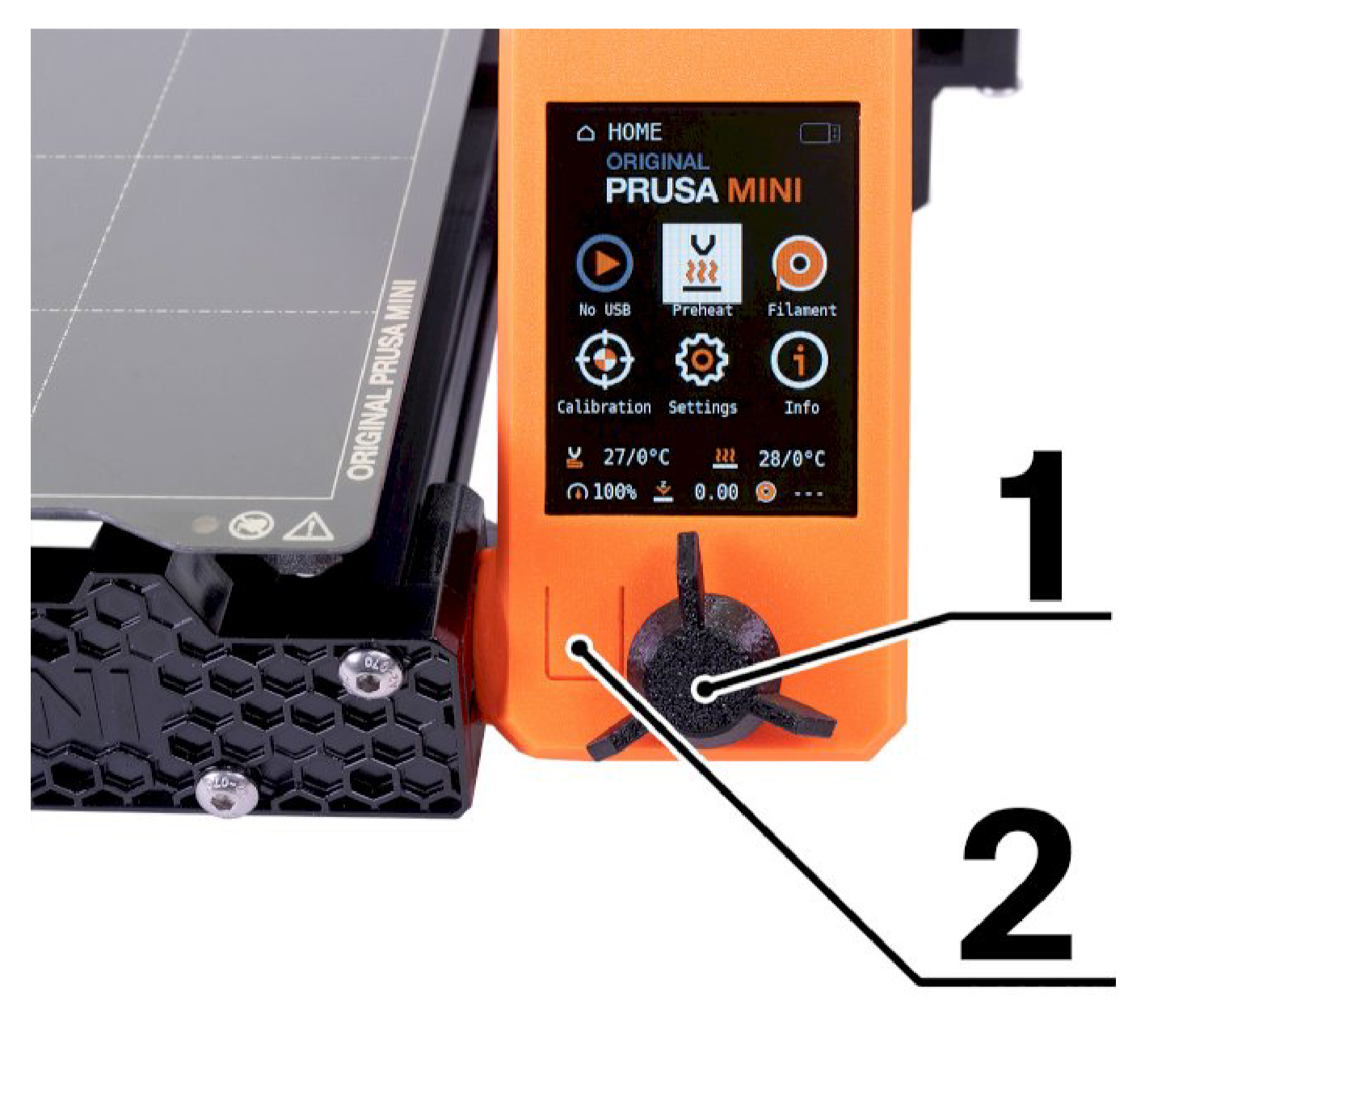
Printer Controls
The black knob (1) is used to change menus and select options. The rectangle (2) is used as a reset and emergency stop.

Slide 7
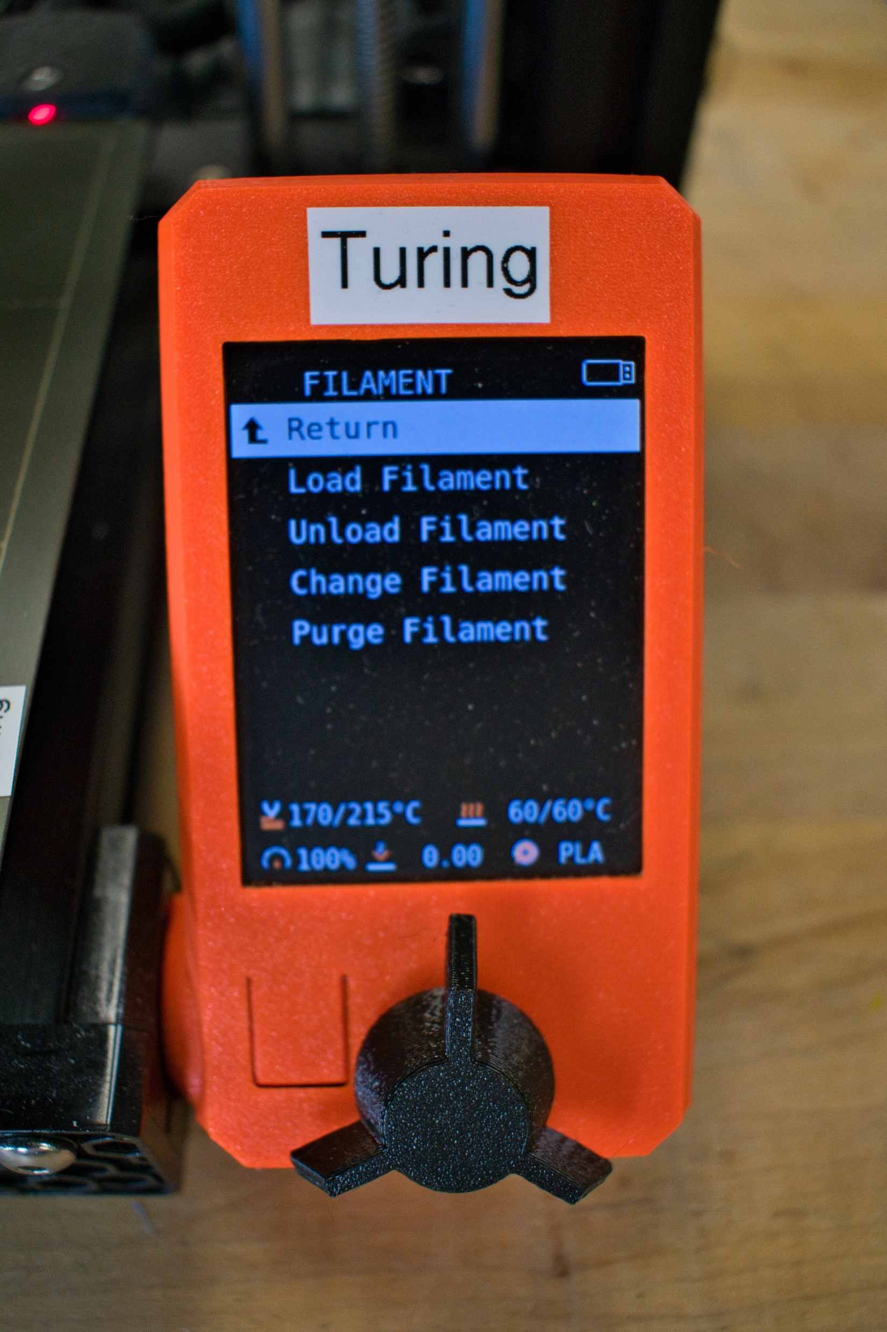
Changing Filament

Slide 8
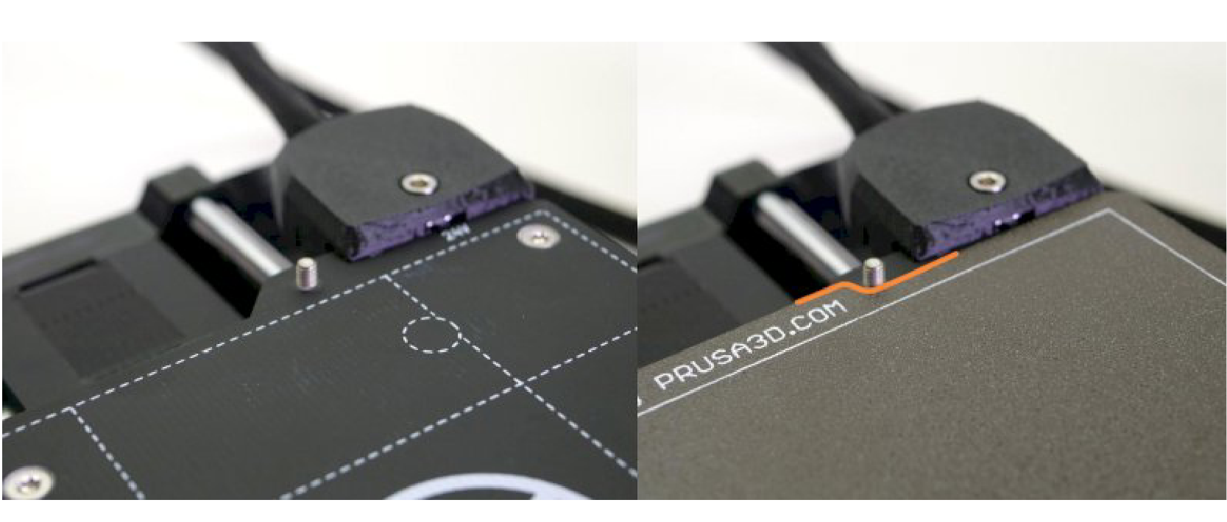
Steel Sheets
Prusa Printers use spring steel sheets and different coatings to provide a surface for the prints to stick to. These sheets are paired to the printer and cannot be switched. These sheets should be aligned by the standoffs as shown above to prevent accidental shifting. Sheets can be cleaned with isopropyl alcohol wipes to remove oils and dust

Slide 9
Prusa Slicer Introduction
Prusa Slicer is the program that takes a design from places like Printables, Thingiverse, or design programs like Fusion 360, Inventor, SOLIDWORKS, etc. and creates a new file called GCODE. GCODE contains the movement paths, tool definitions and more. There are other programs like Cura or Simplify 3D however, these do not have the correct parameters set for our printers.

Slide 10
Prusa Slicer
Open Prusa Slicer here

Slide 11
Prusa Slicer

Slide 12
Prusa Slicer
You should only use profiles with “make717 – “ in front of them. These profiles have been tuned specifically for our printers. You will need to select the printer first, then the print setting, then the filament.

Slide 13
Prusa Slicer

Slide 14
Prusa Slicer
Find and open the orientation piece

Slide 15
Prusa Slicer

Slide 16
Prusa Slicer
This is where basic manipulation of your model(s) can be found. We will start by scaling up the model to 200%

Slide 17
Prusa Slicer
Next is rotation, You can rotate objects a few ways. Other numerically in the menu, the sliders or place on face.

Slide 18
Prusa Slicer

Slide 19
Prusa Slicer
Click the Slice now button

Slide 20
Prusa Slicer

Slide 21
Perimeters
Perimeters are what give your print the majority of it’s strength. This is also where the majority of your weight comes from.

Slide 22
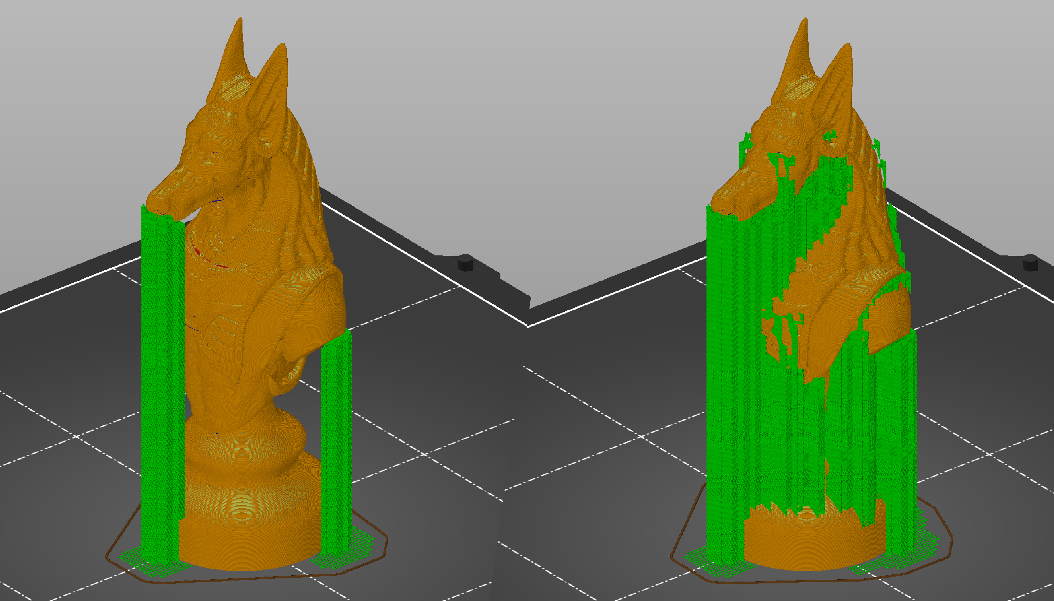
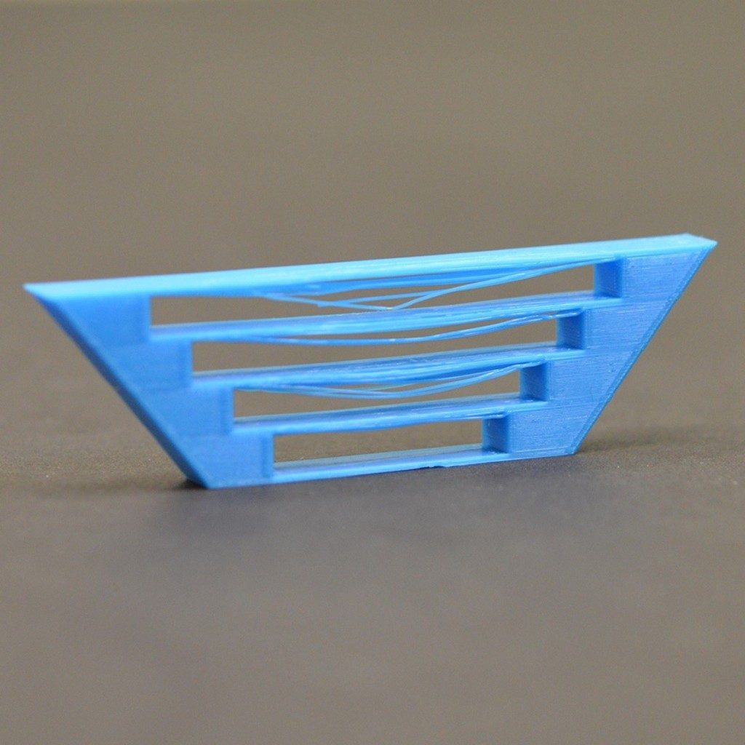
Support Material
Support material allows large overhangs of bridges to form without sagging or warping. This is a structure that is generated by Prusa Slicer and is removable after the print is complete.

Slide 23
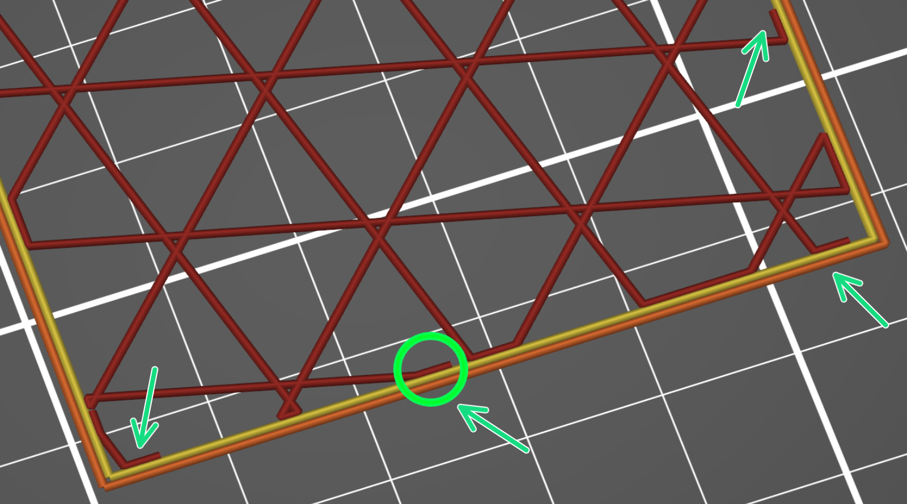
Infill
Infill is a structure generated inside your model so your top shells do not sag. This also helps give some strength to your print but not as much as perimeters. This will also increase weight. Infill percentage should not drop below 10% and not exceed 80%. Values outside of these will potentially result in failed prints and machine damage.

Slide 24
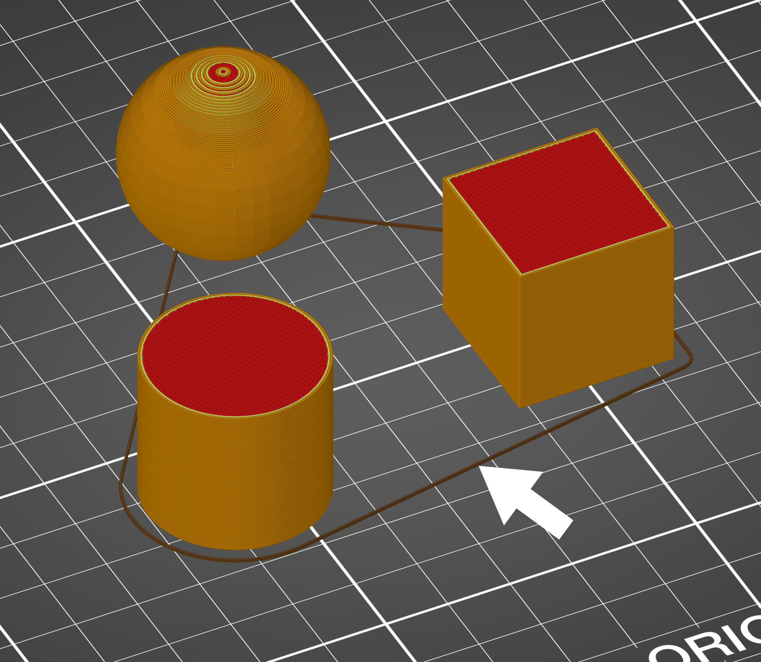
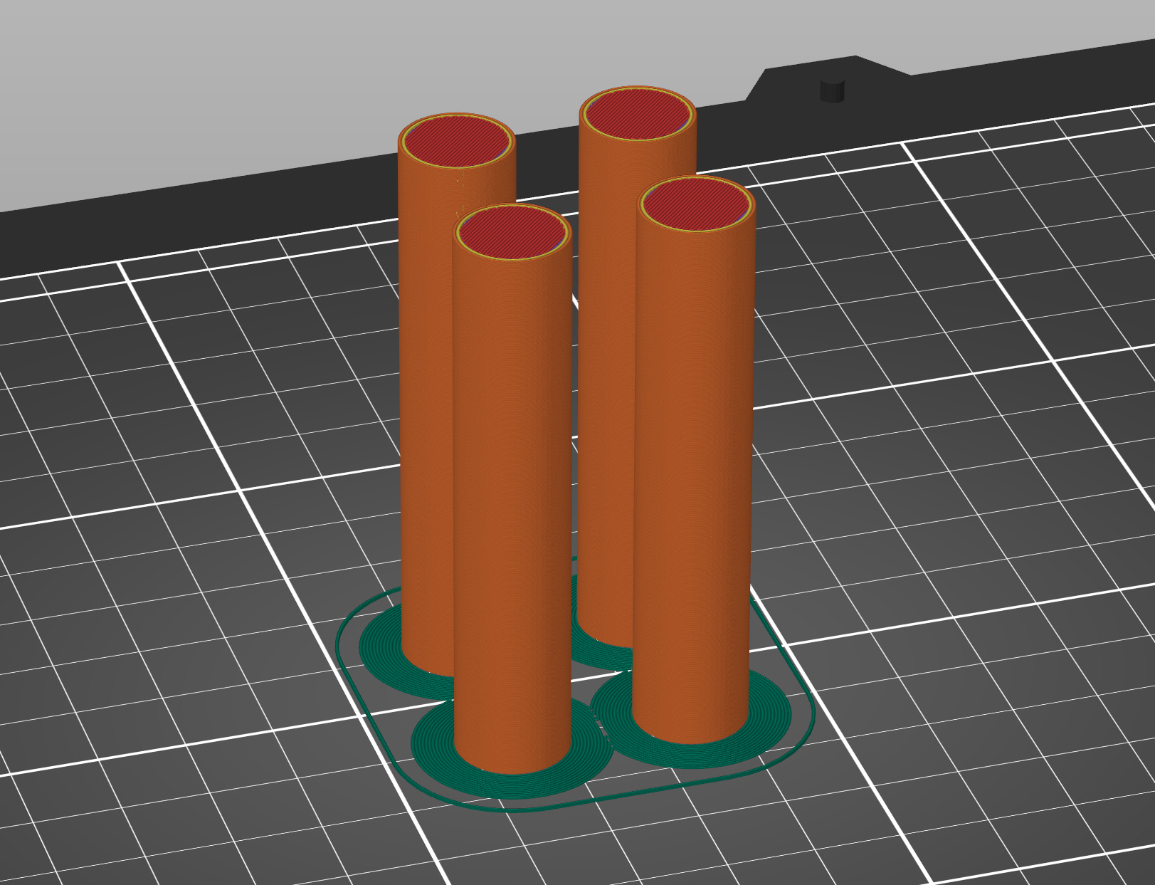
Skirts and Brims
Skirts and Brims are used to prime the extruder and help gauge first layer height. Skirts are not attached to objects while Brims are attached which can help first layer adhesion.

Slide 25
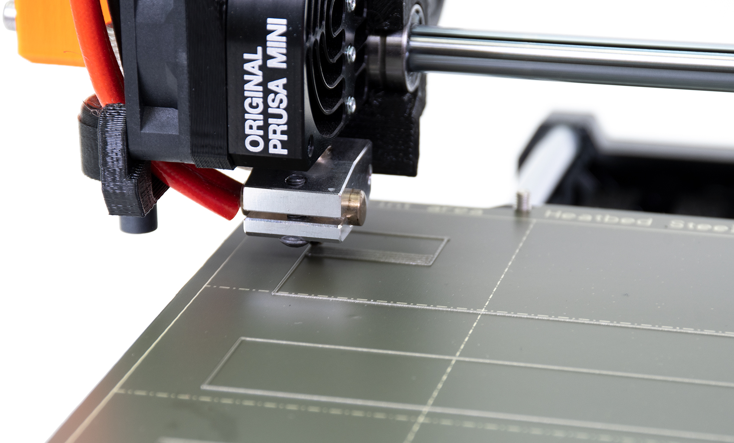
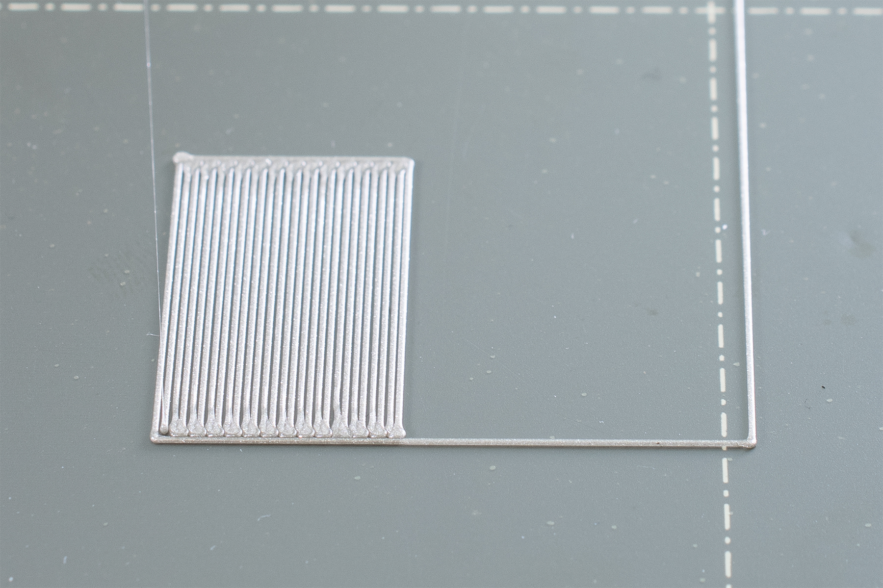
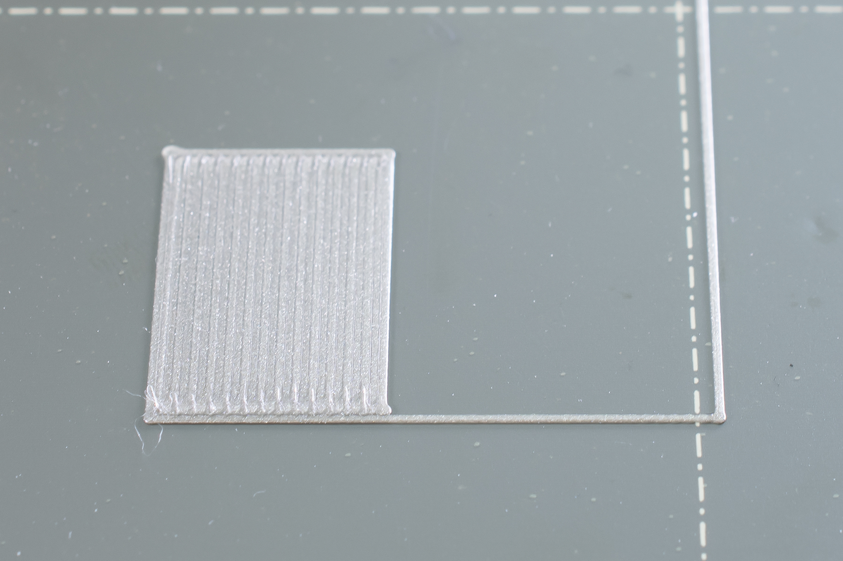
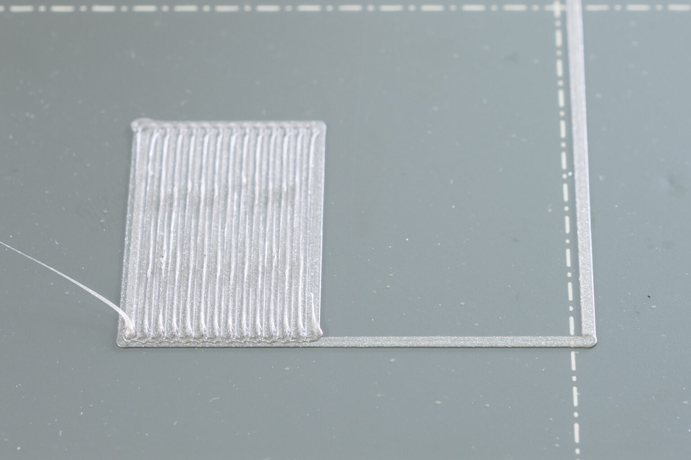
First Layer Calibration
The First Layer is the absolute most important layer. We require you to monitor the first layer before leaving. After this class, you will still not be allowed to change the live z calibration, but it is important to see what is correct and what is not.

Slide 26
3D Printing Theory

Slide 27
Finding Models to Print
3D model files are becoming increasingly common. There are numerous places to find or make 3D files for 3D Printing.

Slide 28
Printables.com

Slide 29
Thingiverse.com

Slide 30
Autodesk Fusion 360

Slide 31
SOLIDWORKS

Slide 32
Paying For Filament
Filament can be paid for in a few different ways. We ask that you accumulate around $15-20 worth as most prints will cost between $0.5 and $2.
You can pay using:
Paypal
Send amount to treasurer@make717.org
Square credit card reader
Use the Square card reader at the front desk as you walk in/out
Cash or check in safe on front desk
Please use envelopes to indicate that the money is for 3D Printing. No coins please.

Slide 33
Bringing your own Filament
You are allowed to bring your own filament. It must be PLA or PLA/PHA only. It cannot have any other additives such as but not limited to carbon fiber, wood, steel, iron, graphite, etc. An up-to-date SDS must be filed before bringing in or using the material here if it is not already pre-approved.

Slide 34
Join Telegram!

